Slide 1

What’s the Use of It?
Logarithmic Function

Slide 2
Table of Contents
Objectives
Competences
Logaritmics Functions
Graphs of the Logarithmics Functions
Transformations of Logarithmic Functions
Common Logarithms
Natural Logarithms
Laws of Logarithms
Bibliography/Sources

Slide 3
Objectives
Data and mathematical relations identifying and relating them in the context they appear.
Qualitative, quantitative, structural and contextual data processing from everyday situations and transforming them into mathematical language.
The use of the algorithms and the mathematical concepts for local or general characterization of a real life situation.
Expression of the quantitative and qualitative characteristics of a concrete situation and of their processing algorithms.
Mathematical modelling of various problems, using different intra-curricular subjects.
Using specific mathematical language in communicating explanations, conducting interdisciplinary investigations and reporting the results.
Develop a positive attitude towards mathematics.

Slide 4
Competences
Know to graph and evaluate the logarithmic functions.
Recognize and analyze exponential and logarithmic functions in everyday situations.
Know the properties of the logarithmic functions.
Solve real life problems involving exponential and logarithmic functions.

Slide 5
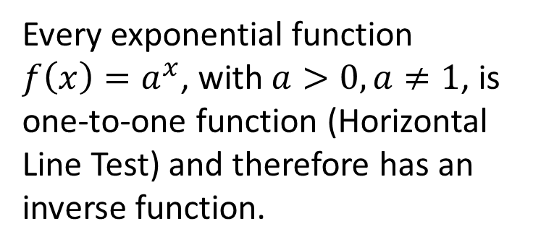
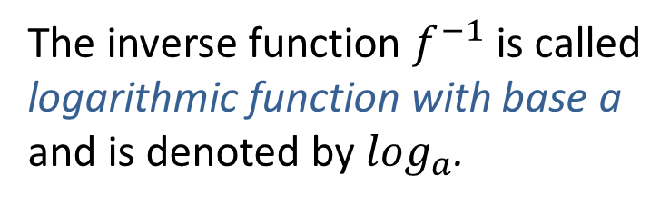
Logarithmic Functions
Every exponential function $f\left(x\right)=a^{x}$, with $a>0,a≠1$, is one-to-one function (Horizontal Line Test) and therefore has an inverse function.
The inverse function $f^{−1}$ is called logarithmic function with base a and is denoted by $\log_{a}$.

Slide 6
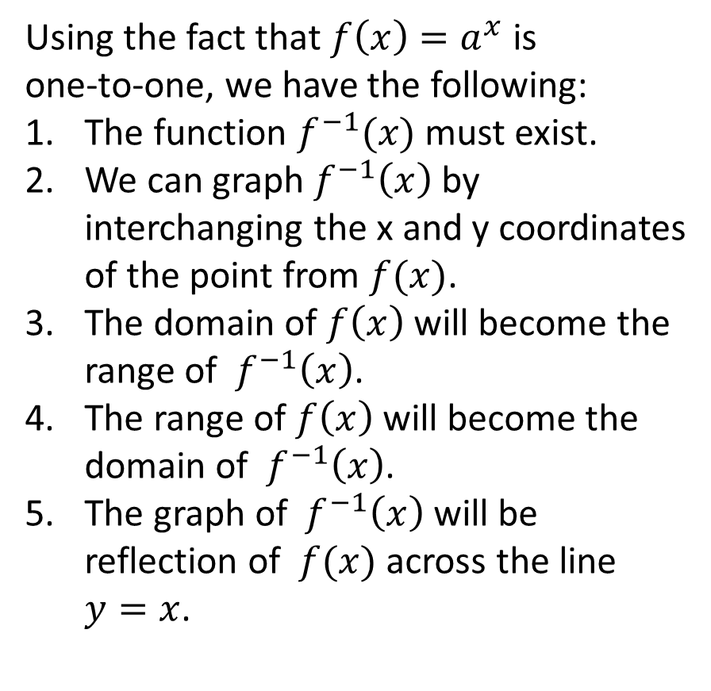
Logarithmic Functions
Using the fact that $f\left(x\right)=a^{x}$ is
one-to-one, we have the following:
The function $f^{−1}(x)$ must exist.
We can graph $f^{−1}\left(x\right)$ by interchanging the x and y coordinates of the point from $f(x)$.
The domain of $f\left(x\right)$will become the range of ${ f}^{−1}\left(x\right)$.
The range of $f\left(x\right)$will become the domain of ${ f}^{−1}\left(x\right)$.
The graph of ${ f}^{−1}\left(x\right)$ will be reflection of $f(x)$ across the line $y=x$.

Slide 7

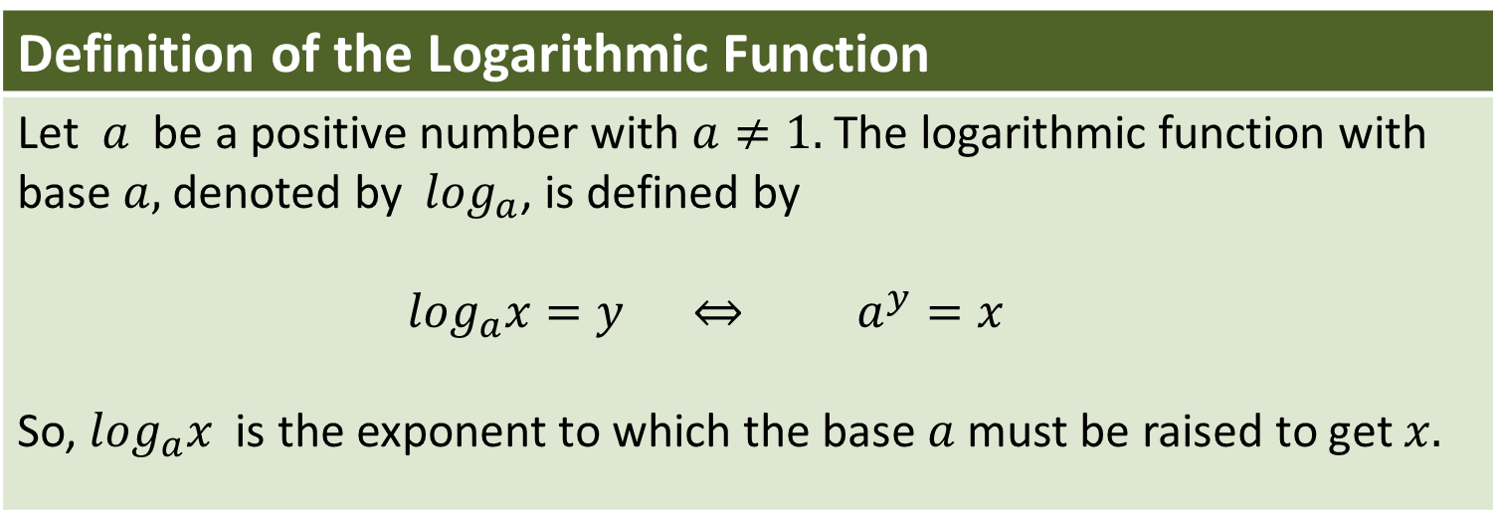

Logarithmic Functions
Definition of the Logarithmic Function
Let $a$ be a positive number with $a≠1.$The logarithmic function with base $a,$denoted by $\log_{a}$, is defined by $\log_{a}x=y ⇔ a^{y}=x$ So, $\log_{a}x$ is the exponent to which the base $a$ must be raised to get $x.$
Logarithmic form
Exponential form
Exponent
Exponent
$$\log_{a}x=y$$
$$a^{y}=x$$
Base
Base

Slide 8

Logarithmic Functions
Example 1:
Rewrite each equation in exponential form:
a) $\log_{3}27=3 ⇔ 3^{3}=27$
b) $\log_{2}32=5 ⇔ 2^{5}=32$
c) $\log_{\frac{1}{2}}16=−4 ⇔ {\left(\frac{1}{2}\right)}^{−4}=16$
d) $\log_{169}13=\frac{1}{2} ⇔ {\left(169\right)}^{\frac{1}{2}}=13$

Slide 9
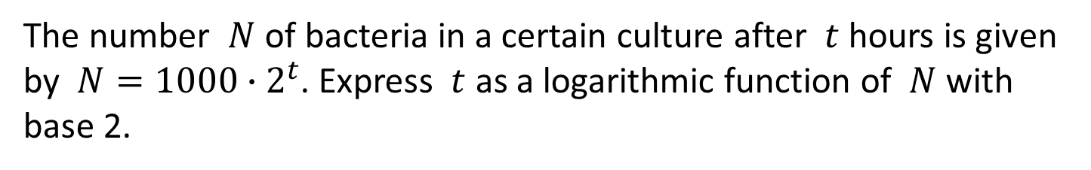

Logarithmic Functions
Example 2:
Changing exponential form to logarithmic form
The number $N$ of bacteria in a certain culture after $t$ hours is given by $N=1000∙2^{t}$. Express $t$ as a logarithmic function of $N$ with base 2.
$N=1000∙2^{t}$ given
$\frac{N}{1000}=2^{t}$ isolate the exponential expression
$t=\log_{2}\frac{N}{1000}$ change to logarithmic form
Solution:

Slide 10
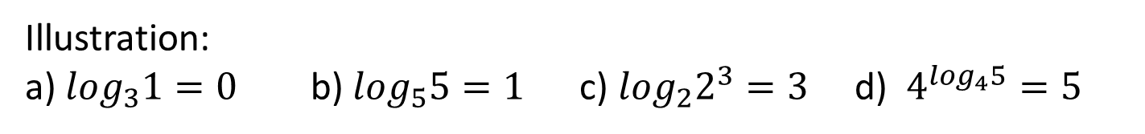
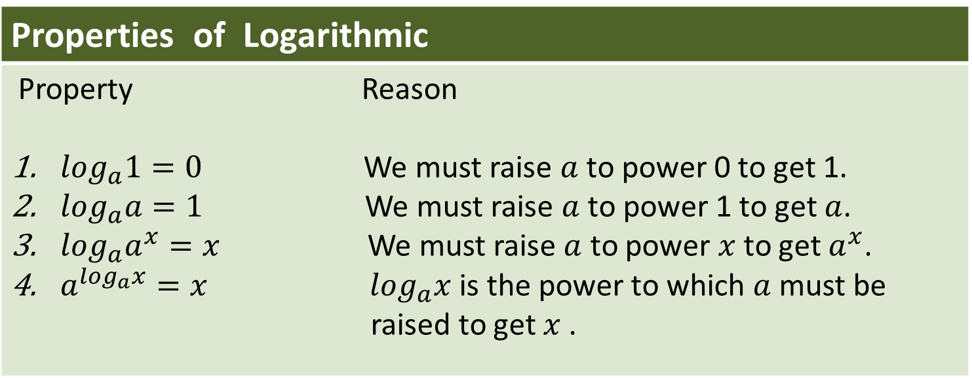
Logarithmic Functions
Properties of Logarithmic
Property Reason $\log_{a}1=0$ We must raise $a$ to power 0 to get 1. $\log_{a}a=1$ We must raise $a$ to power 1 to get $a$. $\log_{a}a^{x}=x$ We must raise $a$ to power $x$ to get $a^{x}$. $a^{\log_{a}x}=x$ $\log_{a}x$ is the power to which $a$ must be raised to get $x$ .
Illustration:
a) $\log_{3}1=0$ b) $\log_{5}5=1$ c) $\log_{2}2^{3}=3$ d) $4^{\log_{4}5}=5$

Slide 11
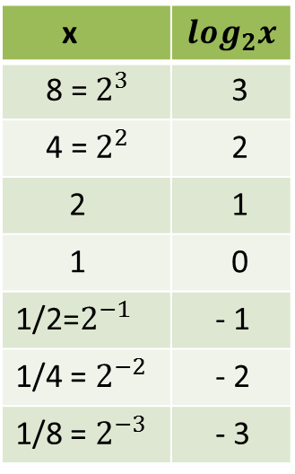
Graph of the Logarithmics
Functions
Sketch the graph of $f\left(x\right)=\log_{2}x.$
Solution:
To make a table of values, we choose the x-values to be powers of 2 that we can easily find their logarithms. We plot these points and connect them with a smooth curve.
x | $$\log_{2}x$$
8 =${ 2}^{3}$ | 3
4 = $2^{2}$ | 2
2 | 1
1 | 0
1/2=$2^{−1}$ | - 1
1/4 = $2^{−2}$ | - 2
1/8 = $2^{−3}$ | - 3

Slide 12
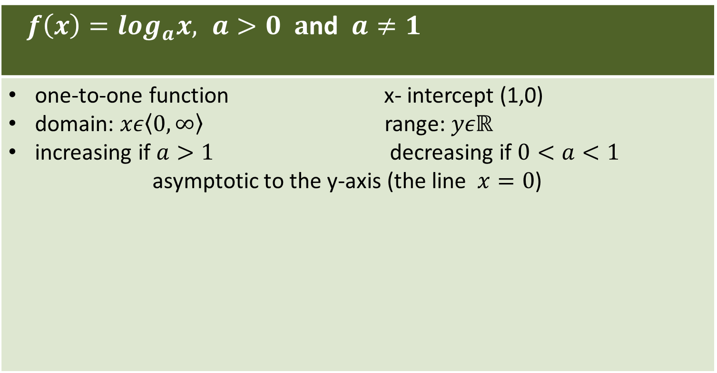
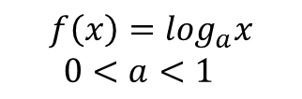

Graph of Logarithmics
Functions
$f\left(x\right)=\log_{a}x, a>0 a$nd $a≠1$
one-to-one function x- intercept (1,0) domain: $xε\left\langle 0,∞\right\rangle$ range: $yεℝ$ increasing if $a>1$ decreasing if $0<a<1$ asymptotic to the y-axis (the line $x=0$)
$$f\left(x\right)=\log_{a}x$$
$a>1$
$$f\left(x\right)=\log_{a}x$$
$0<a<1$

Slide 13
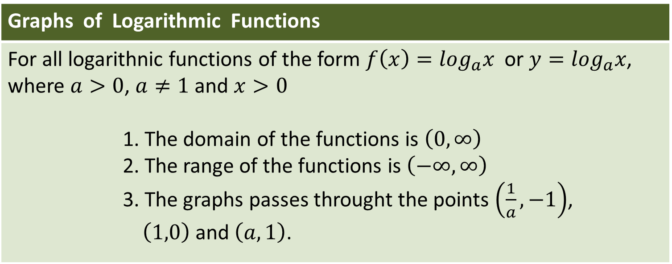
Graph of Logarithmics
Functions
Graphs of Logarithmic Functions
For all logarithnic functions of the form $f\left(x\right)=\log_{a}x$ or $y=\log_{a}x$, where $a>0$, $a≠1$ and $x>0$ 1. The domain of the functions is $\left(0,∞\right)$ 2. The range of the functions is $\left(−∞,∞\right)$ 3. The graphs passes throught the points $\left(\frac{1}{a},−1\right)$, $\left(1,0\right)$ and $\left(a,1\right)$.
In most cases, a reasonably good logarithnic graph can be drawn from just the three points listed in item 3.

Slide 14

Graph of Logarithmics
Functions
Example 3:
Join the logarithmic function with the colour of its graph.
$f\left(x\right)=\log_{4}x$
$f\left(x\right)=\log_{\frac{1}{3}}x$
$f\left(x\right)=\log_{2}x$
$f\left(x\right)=\log_{5}x$
$f\left(x\right)=\log_{\frac{1}{4}}x$

Slide 15
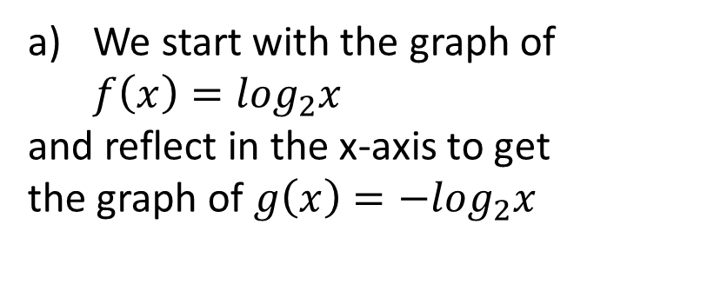
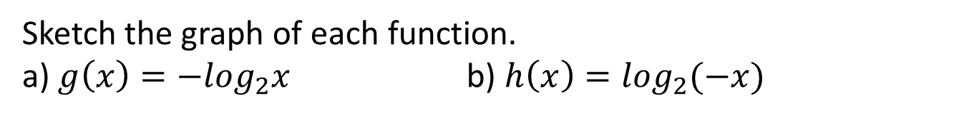
Transformations of Logarithmic
Functions
Example 4:
Reflecting Graphs of Logarithmic Functions
Sketch the graph of each function.
a) $g\left(x\right)=−\log_{2}x$ b) $h\left(x\right)=\log_{2}(−x)$
Solution
We start with the graph of $f\left(x\right)=\log_{2}x$
and reflect in the x-axis to get
the graph of $g\left(x\right)=−\log_{2}x$

Slide 16
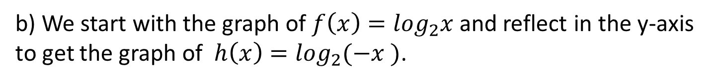
Transformations of Logarithmic
Functions
b) We start with the graph of $f\left(x\right)=\log_{2}x$and reflect in the y-axis to get the graph of $h\left(x\right)=\log_{2}(−x )$.

Slide 17
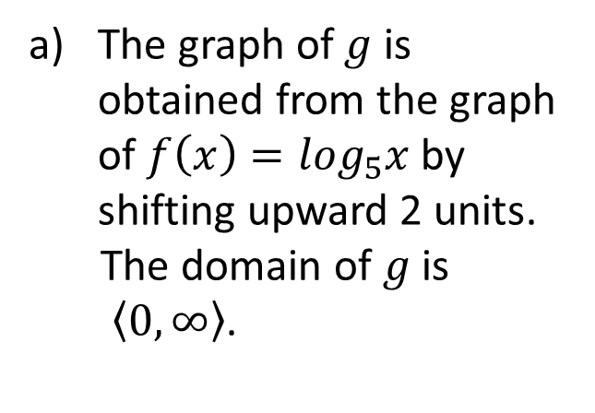
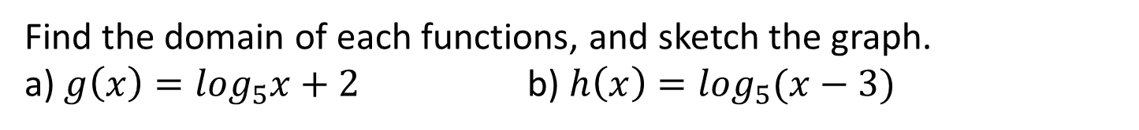
Transformations of Logarithmic
Functions
Example 5:
Shifting Graphs of Logarithmic Functions
Find the domain of each functions, and sketch the graph.
a) $g\left(x\right)=\log_{5}x+2$ b) $h\left(x\right)=\log_{5}(x−3)$
Solution
The graph of $g$ is obtained from the graph of $f\left(x\right)=\log_{5}x$ by shifting upward 2 units.
The domain of $g$ is
$\left\langle 0,∞\right\rangle$.

Slide 18
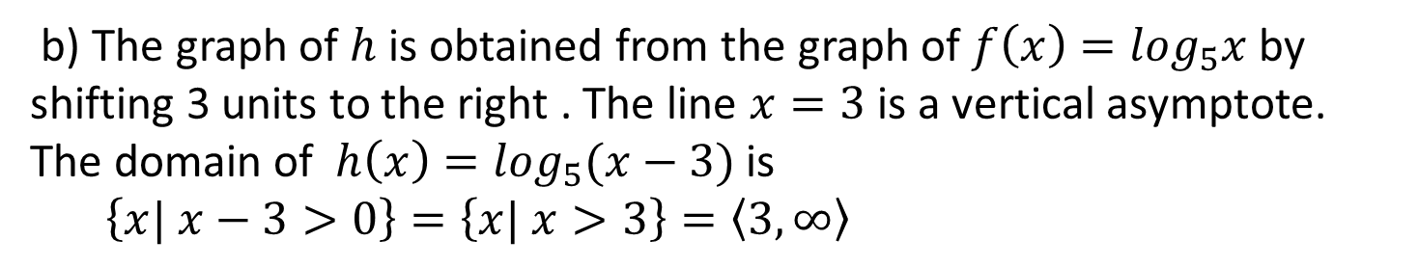
Transformations of Logarithmic
Functions
b) The graph of $h$is obtained from the graph of $f\left(x\right)=\log_{5}x$ by shifting 3 units to the right . The line $x=3$ is a vertical asymptote.
The domain of $h\left(x\right)=\log_{5}(x−3)$ is
$\left\{x| x−3>0\right\}=\left\{x| x>3\right\}=\left\langle 3,∞\right\rangle$
Asymptote x=3

Slide 19
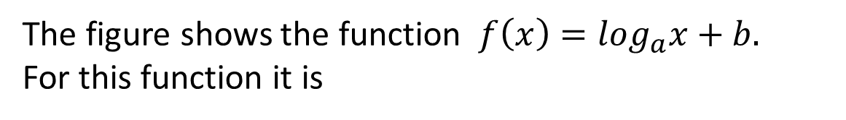
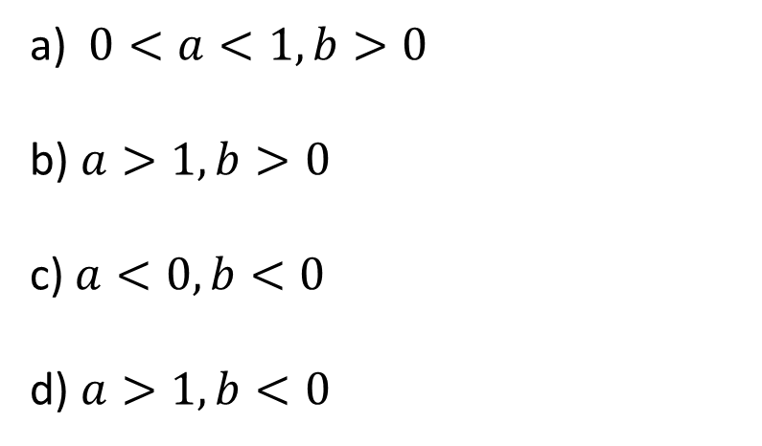
Transformations of Logarithmic
Functions
Example 6:
The figure shows the function $f\left(x\right)=\log_{a}x+b.$
For this function it is
a) $0<a<1,b>0$
b) $a>1,b>0$
c) $a<0, b<0$
d) $a>1,b<0$

Slide 20
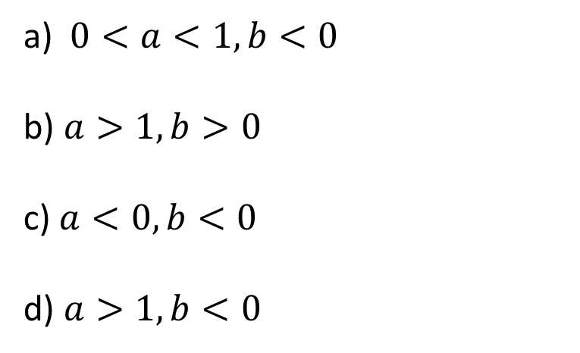
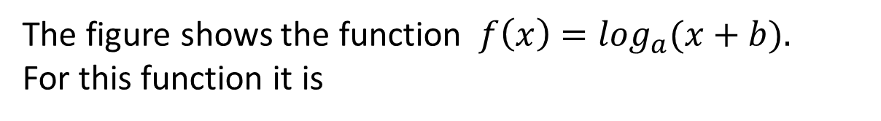
Transformations of Logarithmic
Functions
Example 7:
The figure shows the function $f\left(x\right)=\log_{a}(x+b).$
For this function it is
a) $0<a<1,b<0$
b) $a>1,b>0$
c) $a<0, b<0$
d) $a>1,b<0$

Slide 21

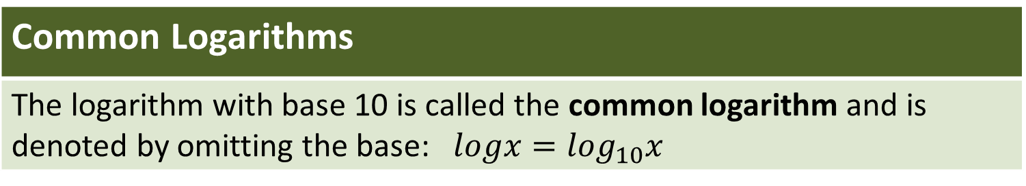
Common Logarithms
Common Logarithms
The logarithm with base 10 is called the common logarithm and is denoted by omitting the base: $logx=\log_{10}x$
From the definitions of logarithms we can easily find that
$log10=1,$ $log100=2$ and $log0.1=−1$

Slide 22
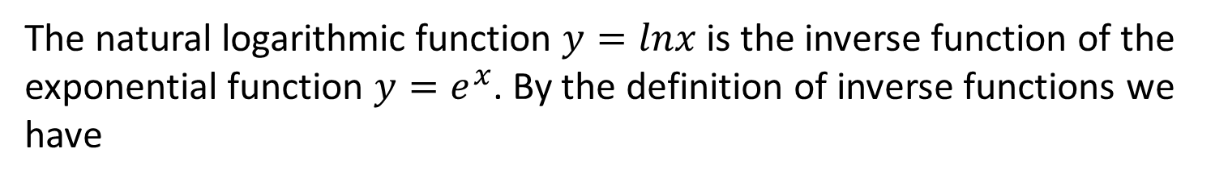
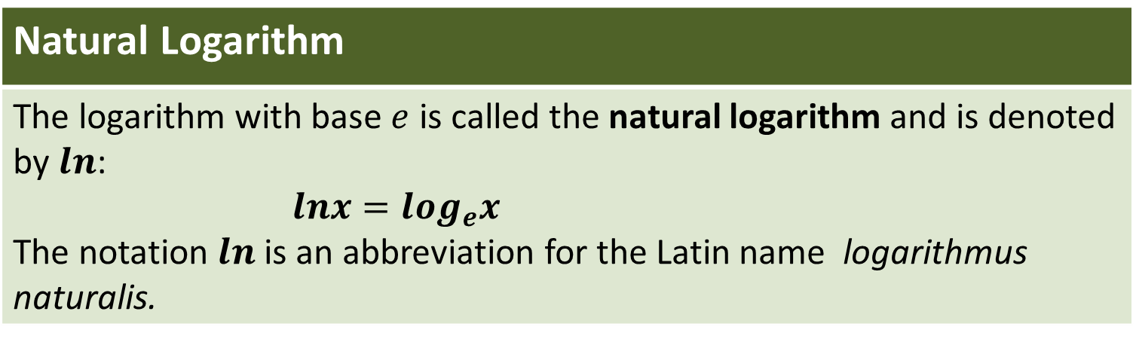

Natural Logarithms
Natural Logarithm
The logarithm with base $e$ is called the natural logarithm and is denoted by $ln$: $lnx=\log_{e}x$ The notation $ln$ is an abbreviation for the Latin name logarithmus naturalis.
The natural logarithmic function $y=lnx$ is the inverse function of the exponential function $y=e^{x}$. By the definition of inverse functions we have
$$lnx=y⇔e^{x}=y$$

Slide 23
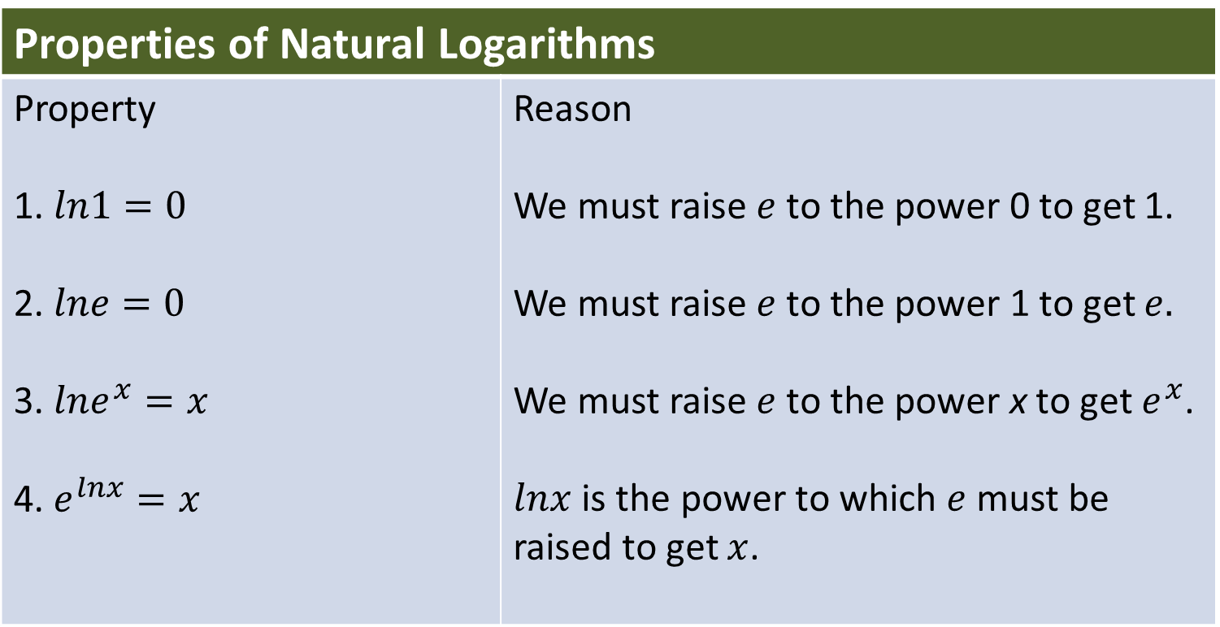
Natural Logarithms
Properties of Natural Logarithms
Property 1. $ln1=0$ 2. $lne=0$ 3. $lne^{x}=x$ 4. $e^{lnx}=x$ | Reason We must raise $e$to the power 0 to get 1. We must raise $e$to the power 1 to get $e.$ We must raise $e$to the power x to get $e^{x}$. $lnx$ is the power to which $e$ must be raised to get $x$.

Slide 24
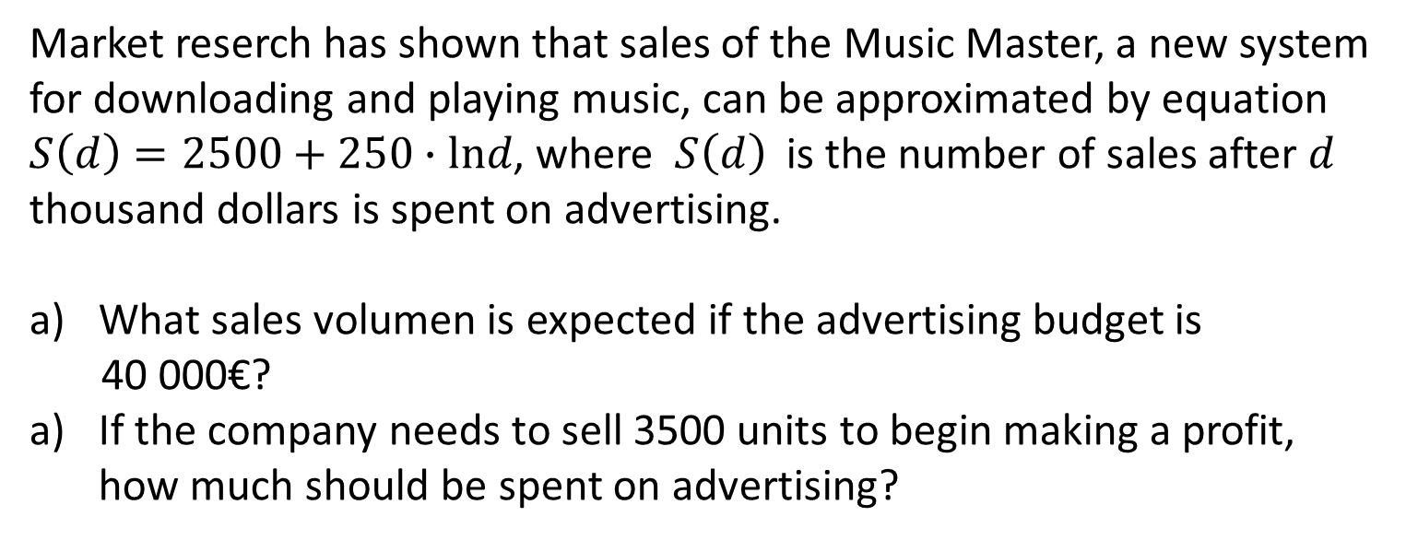
Natural Logarithms
Example 8:
Using Logarithms for Marketing Strategies
Market reserch has shown that sales of the Music Master, a new system for downloading and playing music, can be approximated by equation $S\left(d\right)=2500+250∙lnd$, where $S\left(d\right)$ is the number of sales after $d$ thousand dollars is spent on advertising.
What sales volumen is expected if the advertising budget is
40 000€?
If the company needs to sell 3500 units to begin making a profit, how much should be spent on advertising?

Slide 25
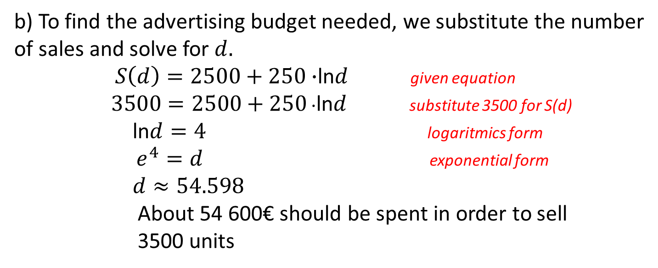
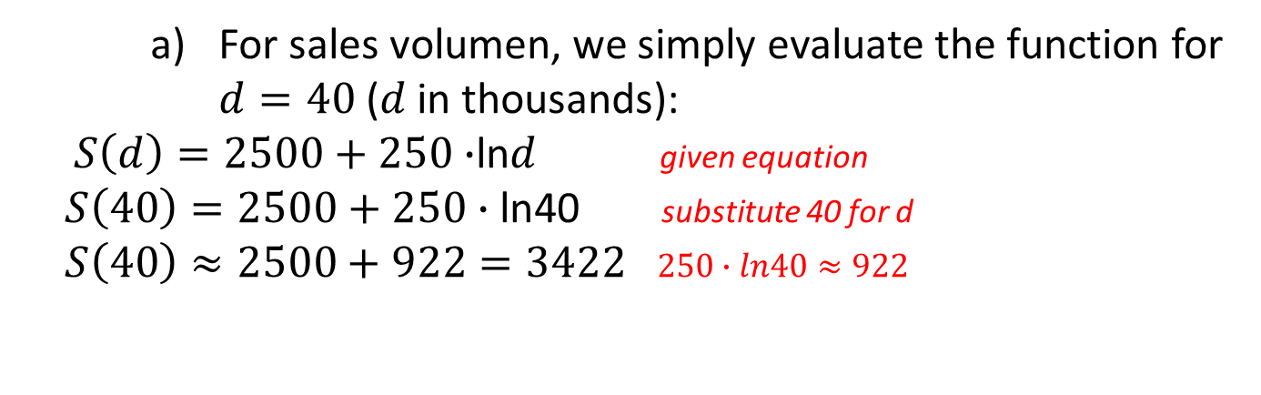
Natural Logarithms
Solution
    For sales volumen, we simply evaluate the function for $d=40$ ($d$ in thousands):
$S\left(d\right)=2500+250∙$ln$d$ given equation
$S\left(40\right)=2500+250∙\text{ln}$40 substitute 40 for d
$S\left(40\right)≈2500+922=3422$ $250∙ln40≈922$
b) To find the advertising budget needed, we substitute the number of sales and solve for $d.$
$S\left(d\right)=2500+250∙$ln$d$ given equation
$3500=2500+250$ $∙$ln$d$ substitute 3500 for S(d)
ln$d=4$ logaritmics form
$e^{4}=d$ exponential form
$d≈54.598$
About 54 600€ should be spent in order to sell
3500 units

Slide 26
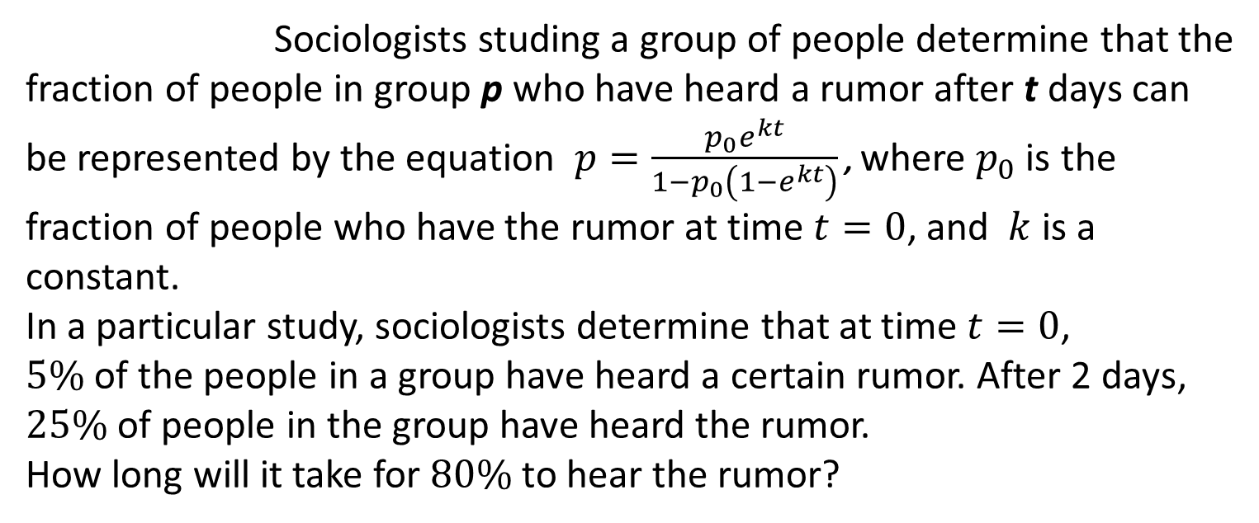
Natural Logarithms
Example 9:
Sociologists studing a group of people determine that the fraction of people in group p who have heard a rumor after t days can be represented by the equation $p=\frac{p_{0}e^{kt}}{1−p_{0}\left(1−e^{kt}\right)}$ , where $p_{0}$is the fraction of people who have the rumor at time $t=0$, and $k$ is a constant.
In a particular study, sociologists determine that at time $t=0$,
$5\%$ of the people in a group have heard a certain rumor. After 2 days, $25\%$ of people in the group have heard the rumor.
How long will it take for $80\%$to hear the rumor?
Solution:
$$k=0.9229, t=4.6925$$

Slide 27
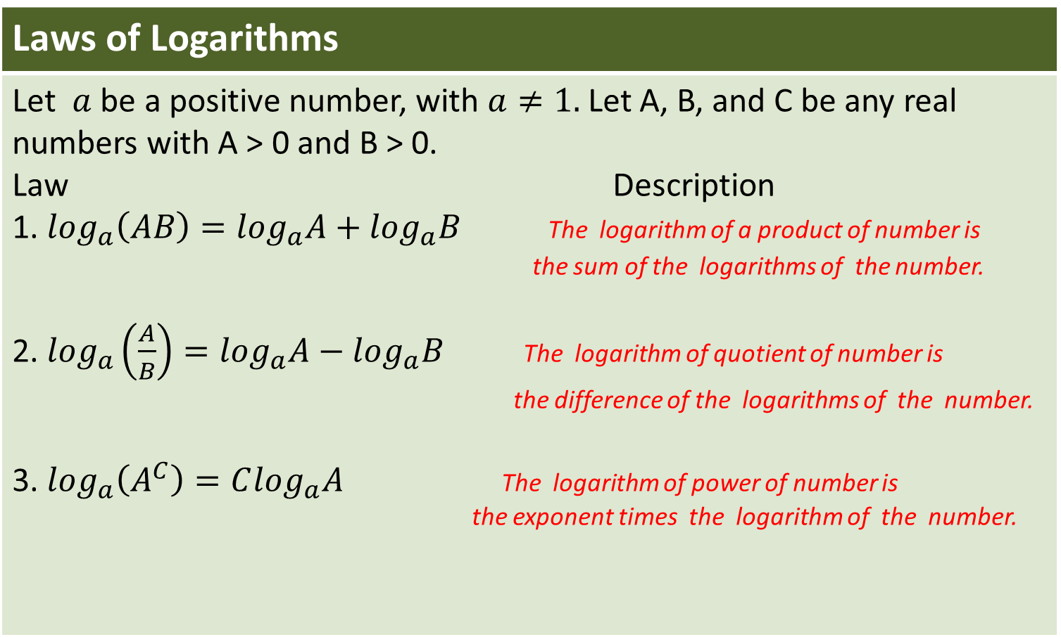
Laws of Logarithms
Laws of Logarithms
Let $a$ be a positive number, with $a≠1.$Let A, B, and C be any real numbers with A > 0 and B > 0. Law Description 1. $\log_{a}\left(AB\right)=\log_{a}A+$ $\log_{a}B$ The logarithm of a product of number is the sum of the logarithms of the number. 2. $\log_{a}\left(\frac{A}{B}\right)=\log_{a}A−$ $\log_{a}B$ The logarithm of quotient of number is the difference of the logarithms of the number. 3. $\log_{a}\left(A^{C}\right)=C\log_{a}A$ The logarithm of power of number is the exponent times the logarithm of the number.

Slide 28
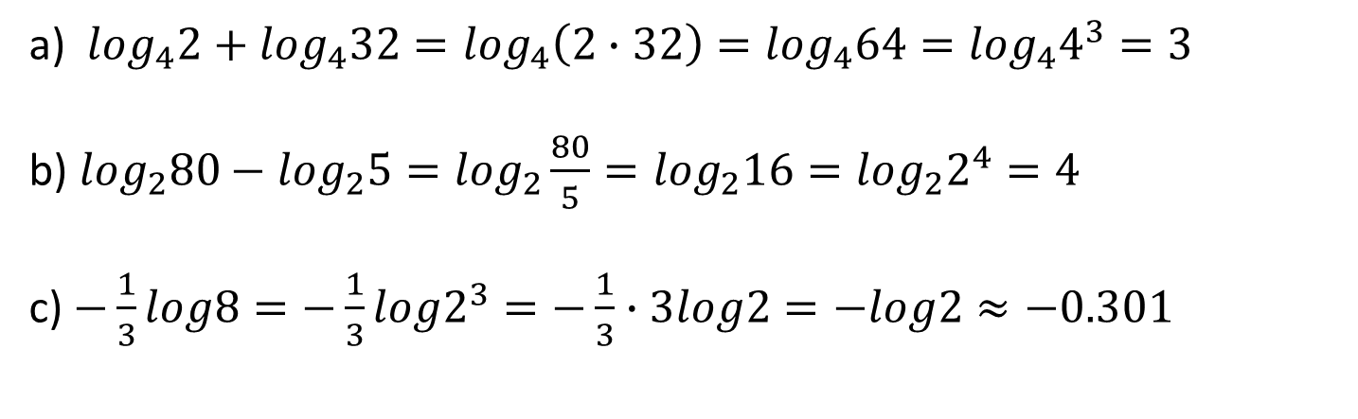
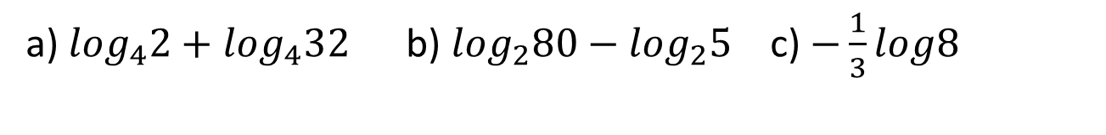
Laws of Logarithms
Example 10:
Using the Laws of Logarithms to Evaluate Expressions.
a) $\log_{4}2+\log_{4}32$ b) $\log_{2}80−\log_{2}5$ c) $−\frac{1}{3}log8$
Solution
a) $\log_{4}2+\log_{4}32=\log_{4}\left(2∙32\right)=\log_{4}64=\log_{4}4^{3}=3$
b) $\log_{2}80−\log_{2}5=\log_{2}\frac{80}{5}=\log_{2}16=\log_{2}2^{4}=4$
c) $−\frac{1}{3}log8=−\frac{1}{3}log2^{3}=−\frac{1}{3}∙3log2=−log2≈−0.301$

Slide 29
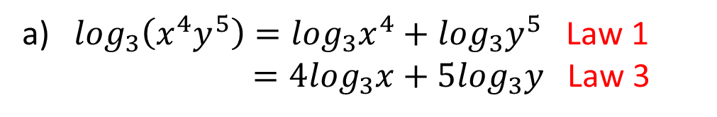
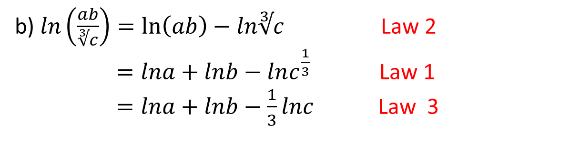
Laws of Logarithms
Example 11:
Use the Laws of Logarithms to expand each expression.
a) $\log_{3}\left(x^{4}y^{5}\right)$ b) $ln\left(\frac{ab}{∛c}\right)$
Solution:
a) $\log_{3}\left(x^{4}y^{5}\right)=\log_{3}x^{4}+\log_{3}y^{5}$ Law 1
$=4\log_{3}x+5\log_{3}y$ Law 3
b) $ln\left(\frac{ab}{∛c}\right)=\ln\left(ab\right)−ln∛c$ Law 2
$=lna+lnb−lnc^{\frac{1}{3}}$ Law 1
$=lna+lnb−\frac{1}{3}lnc$ Law 3

Slide 30
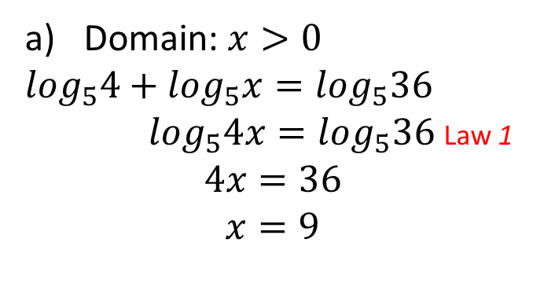
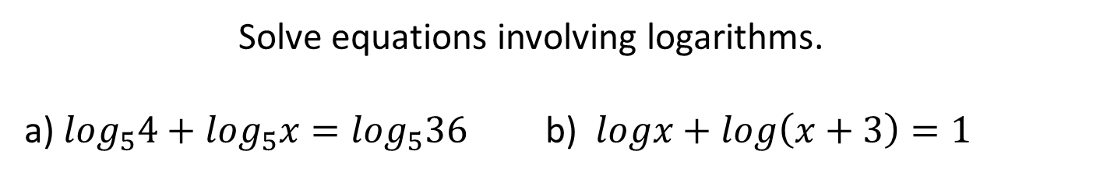
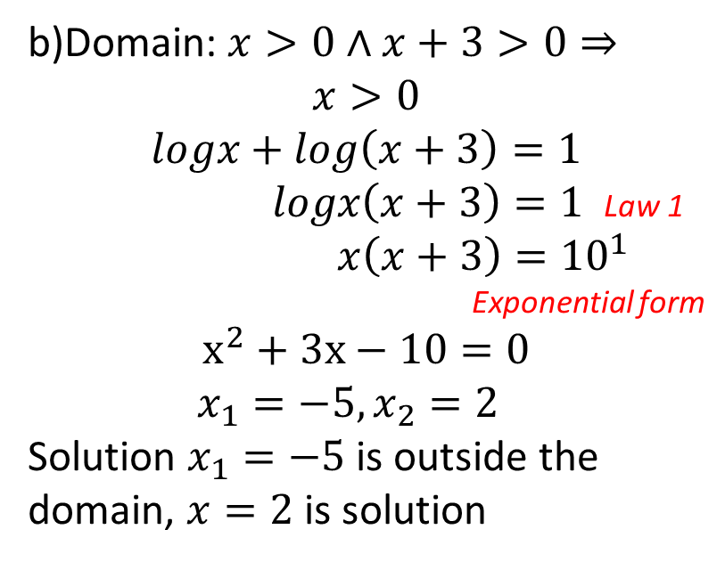
Laws of Logarithms
Example 12:
Solve equations involving logarithms.
a) $\log_{5}4+\log_{5}x=\log_{5}36$ b) $logx+log\left(x+3\right)=1$
Solution:
b)Domain: $x>0∧x+3>0⇒$
$$x>0$$
$$logx+log\left(x+3\right)=1$$
$logx\left(x+3\right)=1$ Law 1
$x\left(x+3\right)={10}^{1}$
Exponential form
$$x^{2}+3x−10=0$$
$x_{1}=−5,x_{2}=2$
Solution $x_{1}=−5$ is outside the domain, $x=2$ is solution
Domain: $x>0$
$\log_{5}4+\log_{5}x=\log_{5}36$
$\log_{5}4x=\log_{5}36$ Law 1
$$4x=36$$
$$x=9$$

Slide 31
Bibliography/Sources
Books:
Stewart, James. Algebra and Trigonometry: Thomson, Brooks/Cole , 2007. Second Edition.
Dakić,Branimir. Matematika 2: Zagreb;Element, 2014. First Edition

